Slide 1
Network Security Applications
AUTHENTICATION

Slide 2
AUTHENTICATION
Over the course of human existence people have had the need to verify their identity, to prove to others that they are who they claim to be.
Security of system resources generally follows a three-step process of Authentication, Authorization, and Accounting (AAA).
This AAA model begins with a positive identification of the person or system seeking access to secured information or services (Authentication)
That person is granted a predetermined level of access to the resources (Authorization).
The user of each asset is logged (Accounting)
bmuwonge@cit.mak.ac.ug
MCN 7103: System And Network Security

Slide 3
AUTHENTICATION
The amount of security implemented in the authentication process should be proportional to the resources that are being protected.
Initially, usernames and passwords were adequate for allowing people access to what they wanted on a network.
Modern techniques include: usernames and passwords, Kerberos, Challenge Handshake Authentication Protocol (CHAP), mutual authentication, digital certificates, tokens, biometrics, and multi-factor authentication.
bmuwonge@cit.mak.ac.ug
MCN 7103: System And Network Security

Slide 4
USERNAMES AND PASSWORDS
A username is a unique identifier that we use to identify ourselves to a computer or network when we log on.
The username should be equally treated as a part of the authentication key and held in a similar confidence to the password.
A password is a secret combination of key strokes that when combined with your username authenticates you to the computer or network system.
The proliferation of computing has led to the use of weak personal password techniques. These weak techniques are the root of the problem with passwords.
bmuwonge@cit.mak.ac.ug
MCN 7103: System And Network Security

Slide 5
BASIC RULES REGARDING PASSWORD PROTECTION
Passwords must be memorized. If they must be written down, the written records must be locked up.
Each password you choose must be different from any other that you use.
Passwords must be at least six characters long, and probably longer, depending on the size of the character set used.
Passwords must contain a mixture of letters (both uppercase and lowercase), numbers, and other characters, such as %,!, #, @ or &.
Passwords must be changed periodically.
bmuwonge@cit.mak.ac.ug
MCN 7103: System And Network Security

Slide 6
PASSWORDS
It is important to choose passwords that are easy to remember but difficult to recognize.
Example: “ April showers bring May flowers”
Take the first letters add a number and punctuation mark.
AsbMf5!
The key is that your password means something to you and it creates a strong password, one that cannot be easily guessed or quickly discovered using brute force attack.
bmuwonge@cit.mak.ac.ug
MCN 7103: System And Network Security

Slide 7
KERBEROS
The model called Kerberos was named after the three-headed dog that guarded the entrance to Hades in Greek mythology.
The three heads of Kerberos comprise the Key Distribution Center (KDC), the client user and the server with the desired service to access.
Although Kerberos 4 is still in use in a few environments, Kerberos 5 is also available.
bmuwonge@cit.mak.ac.ug
MCN 7103: System And Network Security

Slide 8
Kerberos Authentication
Provides authentication and encryption through standard clients and servers
Based on the concept of a trusted third party
    Uses a Key Distribution Center (KDC) to issue tickets to those who want access to resources
    Performs same function as a Certification authority (CA)
    Used internally on Windows 2000/XP
Advantages
    Passwords are not stored on the system
    Widely used in UNIX environment; enables authentication across operating systems
bmuwonge@cit.mak.ac.ug
MCN 7103: System And Network Security

Slide 9
Kerberos Authentication
Kerberos builds on symmetric key cryptography and requires a trusted third party
  Each computer has a secret key (code) used in encryption
  The code provides the key to decoding the message.
    Requires that you know which computers will be talking to each other so you can install the key on each one.
bmuwonge@cit.mak.ac.ug
MCN 7103: System And Network Security

Slide 10
KERBEROS ASSUMPTIONS
Kerberos makes certain assumptions about the environment in which it operates.
  Password-guessing attacks are not solved by Kerberos.
    An attacker can use a dictionary attack to decrypt a key if a user chooses a weak password.
  Assumes workstations, servers, and other devices connected to the networks are physically secure, and there is no way for an attacker to gain access to a password by establishing a position between the user and the service being sought.
bmuwonge@cit.mak.ac.ug
MCN 7103: System And Network Security

Slide 11
KERBEROS ASSUMPTIONS
  You must keep your password secret. If you share your password with untrustworthy individuals, or send the password in plaintext e-mail, an attacker can easily gain access to your private services.
  DoS attacks are not prevented by Kerberos.
  The Authentication Server (AS) and any other server that maintains a cache of master keys must be secure.
    If an attacker gains access to the AS then he or she can impersonate any authorized user on the network.
bmuwonge@cit.mak.ac.ug
MCN 7103: System And Network Security

Slide 12
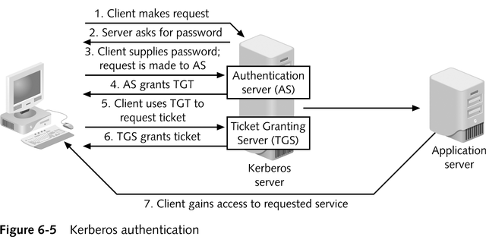
Kerberos Authentication
bmuwonge@cit.mak.ac.ug
MCN 7103: System And Network Security

Slide 13
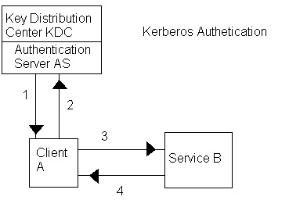
KERBEROS AUTHENTICATION PROCESS
bmuwonge@cit.mak.ac.ug
MCN 7103: System And Network Security

Slide 14
KERBEROS AUTHENTICATION PROCESS
Maria is Client A. She logs on and sends a request to the authentication server AS for credentials to access Service B. The request is encrypted using Maria’s master key (typically a memorized password and/or other authenticating data), which the AS has in its database of encryption keys.
The AS decrypts the request using Maria’s master key and verifies that the request came from her. The AS then creates two copies of a new session key . It encrypts one of the copies, called a ticket and identified as “A”, with Maria’s master key, and then the AS encrypts the other copy of the session key, identified as “B”, with Service B’s master key. After doing so, the AS sends both “A” and “B” back to Maria.
bmuwonge@cit.mak.ac.ug
MCN 7103: System And Network Security

Slide 15
3. Maria’s workstation decrypts “A”, the ticket, using her master key, verifies that the AS has processed the request to use Service B, creates and adds an authenticator containing Maria’s username and timestamp to the ticket and encrypts the ticket and authenticator using the session key. Maria’s workstation then sends “B” (the session key that was encrypted by the AS with the Service’s B master key) and the ticket with the authenticator to Service B.
bmuwonge@cit.mak.ac.ug
MCN 7103: System And Network Security

Slide 16
4. Service B opens “B” using service B’s master key, and extracts the session key. Using the session key, it then opens the authenticator, verifies that the user name and checksum match and that time stamp is valid (that it has been created within a set period of time-five minutes is typical). Once Service B has determined that the session key and the authenticator match, it allows Maria to use its services until the validity period has expired.
bmuwonge@cit.mak.ac.ug
MCN 7103: System And Network Security

Slide 17
In the described scheme Maria has to enter her username and password each time she wants to access the services of a different server (i.e. the printer server, file server, mail server, etc).
Once Maria has been authenticated, the AS sends her a Ticket-Granting Ticket (TGT).
Once Maria has the TGT, she can request services from various network devices by submitting the TGT with the name of the requested service to the ticket-granting server (which may also be the same machine as authentication server) without having to reenter her username and password.
bmuwonge@cit.mak.ac.ug
MCN 7103: System And Network Security

Slide 18
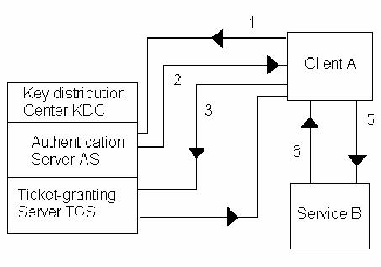
Ticket-granting server
bmuwonge@cit.mak.ac.ug
MCN 7103: System And Network Security

Slide 19
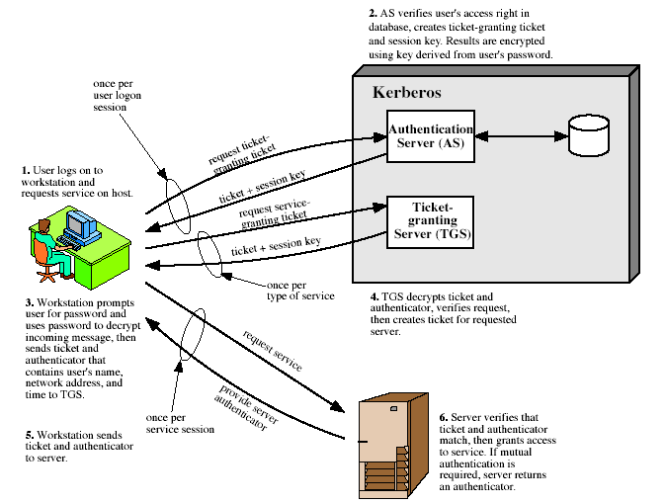
Kerberos 4 Overview
bmuwonge@cit.mak.ac.ug
MCN 7103: System And Network Security
Notes:
Stallings Fig 14-1. Discuss in relation to Table 14-1 which details message exchanges.

Slide 20
When Maria logs on her workstation with her username and password, the workstation automatically sends a request to the AS for a TGT.
The AS receives the request for a TGT, authenticates her, uses Maria’s master key to encrypt a new TGT, and sends it back to Maria’s workstation.
  Now she has a TGT, she does not have to keep authenticating herself to gain access to additional services, at least until the validity period of the TGT expires.
bmuwonge@cit.mak.ac.ug
MCN 7103: System And Network Security

Slide 21
3. Whenever Maria needs a new service, her workstation sends a copy of the TGT, along with the name of the server that holds the application she needs, an authenticator, and the time period that she needs access to each service, to the ticket-granting server TGS requesting a ticket for each of the services she needs.
4. Once the TGS has verified that Maria is in fact who she says she is, using the session key to access her authenticator as in the earlier example, and assuming the TGT matches her to her authenticator, the TGS sends her tickets to use the services she needs.
bmuwonge@cit.mak.ac.ug
MCN 7103: System And Network Security

Slide 22
5.After receiving the appropriate tickets from the TGS, Maria’s workstation verifies that each of them is for a service that she originally requested, and sends a ticket to each of the relevant servers requesting that they allow her to use their services.
6.Each of the servers that receives a request for service verifies that the request came from the same person, or machine, to which the TGS granted the ticket. As each server determines that Maria has the authority to use the service requested, it authorizes her to begin using those services.
bmuwonge@cit.mak.ac.ug
MCN 7103: System And Network Security

Slide 23
Summary of Kerberos Version 4 Message Exchanges
(a) Authentication Service Exchange: to obtain ticket-granting ticket
(1) C -----> AS: ID_{c} || ID_{tgs} || TS₁
(2) AS -----> C:
E_{Kc}[ K_{c,tgs} || ID_{tgs} ||TS₂ || Lifetime₂ || Ticket_{tgs} ]
Ticket_{tgs} = EK_{tgs} [K_{c,tgs} || ID_{C} || AD_{C} || ID_{tgs} ||TS₂ || Lifetime₂ ].
AS responds to C’s request with msg encrypted with K_{c}.
Msg 1 includes a time stamp s.t. AS knows it’s timely.
Msg 2 includes several elements of ticket in form acceptable to C so C can confirm this ticket is for TGS & learn its expiration time.
bmuwonge@cit.mak.ac.ug
MCN 7103: System And Network Security

Slide 24
(b) Ticket-Granting Service Exchange: to obtain service-granting ticket
(3) C -----> TGS: ID_{v} || Ticket_{tgs} || Authenticator_{c}
(4) TGS -----> C:
EK_{c,tgs} [K_{c,v} || ID_{v} ||TS₄ || Ticket_{v} ]
Ticket_{tgs} = E_{Ktgs} [K_{c,tgs} || ID_{C} || AD_{C} || ID_{tgs} ||TS₂ || Lifetime₂ ]

Ticket_{v} = E_{Kv}[ K_{c,v} || ID_{C} || AD_{C} || ID_{v} ||TS₄ || Lifetime₄ ]
Authenticator_{c} = E_{Kc,tgs}[ ID_{C} || AD_{C} ||TS₃ ]
C sends a msg to TGS including ticket + ID of requested service.
C also transmits an authenticator which includes ID & address of C’s user & time stamp. C has session key, K_{c,tgs} .
Authenticator proves client’s identity.
TGS sends encrypted msg to C including session key to be shared btn C & server V, ID of V, & timestamp of ticket.
Ticket includes the same session key.
bmuwonge@cit.mak.ac.ug
MCN 7103: System And Network Security

Slide 25
(c) Client/Server Authentication Exchange: to obtain service
(5) C -----> V: Ticket_{v} || Authenticator_{c}
(6) V -----> C:
E_{Kc,v} [TS₅ +1] (for mutual authentication)
Ticket_{v} = E_{Kv} [K_{c,v} || ID_{C} || AD_{C} || ID_{v} ||TS₄ || Lifetime₄ ]
Authenticator_{c} = E_{Kc,v}[ ID_{C} || AD_{C} ||TS₅ ].
    C now has a reusable service-granting ticket for V.
    When V presents this ticket (msg(5)), it also sends an authenticator. The server can decrypt the ticket, recover session key, & decrypt the authenticator.
    If mutual authentication is required, server can reply as in msg(6). Server returns timestamp value from authenticator, incremented by 1 & encrypted in session key. C can decrypt this msg to recover incremented timestamp. Client & server share a secret key that can be used to encrypt future msgs or exchange new random key.
bmuwonge@cit.mak.ac.ug
MCN 7103: System And Network Security

Slide 26
In very large organizations, Kerberos employs multiple authentication servers, each of which is responsible for a subset of users and servers in the Network system. Each of these subsets is called realm.
Cross-realm authentication must occur in order for a client to use a service that is running in a realm other than its own.
bmuwonge@cit.mak.ac.ug
MCN 7103: System And Network Security

Slide 27
Security Weaknesses of Kerberos
Not effective against password guessing attacks; if a user chooses a poor password, then an attacker guessing that password can impersonate the user.
Requires a trusted path through which passwords are entered. If the user enters a password to a program that has already been modified by an attacker, or if the path between the user and the initial authentication program can be monitored, then an attacker may obtain sufficient information to impersonate the user.
It does not protect all messages sent between two computers; it only protects the messages from software that has been written or modified to use it.
bmuwonge@cit.mak.ac.ug
MCN 7103: System And Network Security

Slide 28
X.509 Authentication Service
Part of the X.500 series that define a directory service.
  A distributed set of servers maintaining some user info DB.
Defines framework for authentication services to users.
  Directory may store public-key certificates
  Each certificate contains public key of user
  Signed with private key of a trusted certification authority
Also defines authentication protocols.
Uses public-key cryptography & digital signatures
  algorithms not standardised, but RSA recommended
Used in a variety of contexts
  S/MIME
  IP security
  SSL/TLS, SET
bmuwonge@cit.mak.ac.ug
MCN 7103: System And Network Security
Notes:
X.509 is the Internationally accepted standard for how to construct a public key certificate, and is becoming widely used. It has gone through several versions. It is used by S/MIME secure email, SSL/TLS secure Internet links (eg for secure web).

Slide 29
X.509 Certificates
Issued by a Certification Authority (CA), containing:
  version (1, 2, or 3)
  serial number (unique within CA) identifying certificate
  signature algorithm identifier and parameters
  issuer X.500 name (CA)
  period of validity (from - to dates)
  subject X.500 name (name of owner)
  subject public-key info (algorithm, parameters, key)
  issuer unique identifier (v2+)
  subject unique identifier (v2+)
  extension fields (v3)
  signature (of hash of all fields in certificate)
notation CA<<A>> denotes certificate for A signed by CA
bmuwonge@cit.mak.ac.ug
MCN 7103: System And Network Security
Notes:
The X.509 certificate is the heart of the standard. There are 3 versions, with successively more info in the certificate - must be v2 if either unique identifier field exists, must be v3 if any extensions are used.

Slide 30
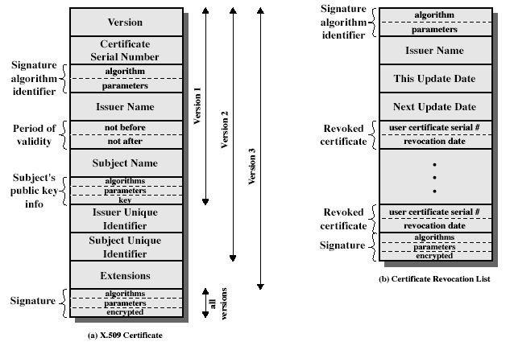
X.509 Certificates
bmuwonge@cit.mak.ac.ug
MCN 7103: System And Network Security
Notes:
Stallings Fig 14.3

Slide 31
Obtaining a Certificate
Any user with access to CA can get any certificate from it
Only the CA can modify a certificate
Because cannot be forged, certificates can be placed in a public directory
bmuwonge@cit.mak.ac.ug
MCN 7103: System And Network Security

Slide 32
CA Hierarchy
If both users share a common CA then they are assumed to know its public key
Otherwise CA's must form a hierarchy
use certificates linking members of hierarchy to validate other CA's
  each CA has certificates for clients (forward) and parent (backward)
each client trusts parents certificates
enable verification of any certificate from one CA by users of all other CAs in hierarchy
bmuwonge@cit.mak.ac.ug
MCN 7103: System And Network Security
Notes:
All very easy is both parties use the same CA. If not, then there has to be some means to form a chain of certifications between the CA's used by the two parties. And that raises issues about whether the CA's are equivalent, whether they used the same policies to generate their certificates, and how much you're going to trust a CA at some remove from your own. These are all open issues.

Slide 33
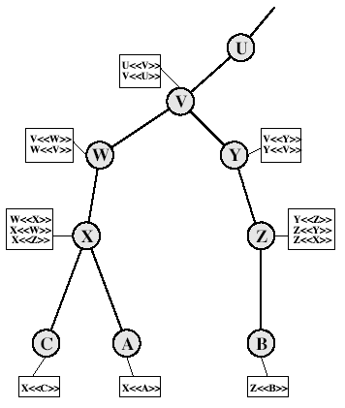
CA Hierarchy Use
Connected circles indicate hierarchical r/ship among CAs.
Associated boxes indicate certificates maintained in the directory for each CA entry.
The directory entry for each CA includes 2 types of cert:
  Forward cert: Certs of X generated by other CAs.
  Reverse Cert: Generated by X that are the certs of other CAs.
In this example, user A can acquire the certs from the directory to establish a certification path to B.
X<<W>>W<<V>>V<<Y>>Y<<Z>>Z<<B>>
bmuwonge@cit.mak.ac.ug
MCN 7103: System And Network Security
Notes:
Stallings Fig 14.4.
Track chains of certificates:
A acquires B certificate using chain: X<<W>>W<<V>>V<<Y>>Y<<Z>>Z<<B>>
B acquires A certificate using chain: Z<<Y>>Y<<V>>V<<W>>W<<X>>X<<A>>

Slide 34
Certificate Revocation
certificates have a period of validity
may need to revoke before expiry, eg:
  user's private key is compromised
  user is no longer certified by this CA
  CA's certificate is compromised
CA’s maintain list of revoked certificates
  the Certificate Revocation List (CRL)
users should check certs with CA’s CRL
bmuwonge@cit.mak.ac.ug
MCN 7103: System And Network Security

Slide 35
Authentication Procedures
X.509 includes three alternative authentication procedures:
  One-Way Authentication
  Two-Way Authentication
  Three-Way Authentication
All use public-key signatures
bmuwonge@cit.mak.ac.ug
MCN 7103: System And Network Security
Notes:
The X.509 standard specifies the authentication protocols that can be used when obtaining and using certificates. 1-way for unidirectional messages (like email), 2-way for interactive sessions when timestamps are used, 3-way for interactive sessions with no need for timestamps (and hence synchronised clocks).

Slide 36
One-Way Authentication
One message ( A->B) used to establish
    the identity of A and that message is from A
    That message was intended for B
    integrity & originality of message - not sent multiple times
message must include timestamp, nonce, B's identity and is signed by A.
The identity of the initiating entity is verified in the process not that of the responding entity.
bmuwonge@cit.mak.ac.ug
MCN 7103: System And Network Security

Slide 37
Two-Way Authentication
2 messages (A->B, B->A) which also establishes in addition:
  the identity of B and that reply is from B
  that reply is intended for A
  integrity & originality of reply
reply includes original nonce from A, also timestamp and nonce from B
bmuwonge@cit.mak.ac.ug
MCN 7103: System And Network Security

Slide 38
Three-Way Authentication
Three messages (A->B, B->A, A->B) which enables above authentication without synchronized clocks
has reply from A back to B containing signed copy of nonce from B
means that timestamps need not be checked or relied upon because both nonces are echoed back by the other side, each side can check the returned nonce to detect replay attacks.
Approach needed when synchronized clocks are not available.
bmuwonge@cit.mak.ac.ug
MCN 7103: System And Network Security

Slide 39
X.509 Version 3
Has been recognised that additional information is needed in a certificate
    Subject field inadequate for applns recognise entity by e-mail address, URL, or other Internet related ID.
    Security policy details,
    Setting usage constraints to control malicious CAs
    Identify diff keys used by same owner at diff times.
    Subject field is inadequate to convey key owner ID to public key user.
rather than explicitly naming new fields, X.509 defined a general extension method
extensions consist of:
  extension identifier
  criticality indicator
  extension value
bmuwonge@cit.mak.ac.ug
MCN 7103: System And Network Security

Slide 40
Certificate Extensions
Key and policy information
  convey info about subject & issuer keys, plus indicators of certificate policy. This area includes:
    CA key ID, Subject key ID, Key usage(restrictions imposed), Private key usage period, Cert policies, Policy mappings
Certificate subject and issuer attributes
  support alternative names, in alternative formats, for certificate subject and/or issuer.
  Can convey additional info about cert subj. e.g., subject alternative name & directory attributes, issuer alt name
Certification Path Constraints
  allow constraints on use of certificates by other CA’s. Extension fields here: [Basic, Name & Policy] constraints
bmuwonge@cit.mak.ac.ug
MCN 7103: System And Network Security

Slide 41
Challenge Handshake Authentication Protocol (CHAP)
CHAP is a point-to-point protocol (PPP) mechanism used by an authenticator (usually a PPP network server) to authenticate a peer, usually a host or router that connects through switched circuits or dial-up lines to a PPP network.
CHAP ensures that the authenticator is communicating with an authorized peer by issuing challenge messages at the beginning of the communication and periodically throughout the communication session.
bmuwonge@cit.mak.ac.ug
MCN 7103: System And Network Security

Slide 42
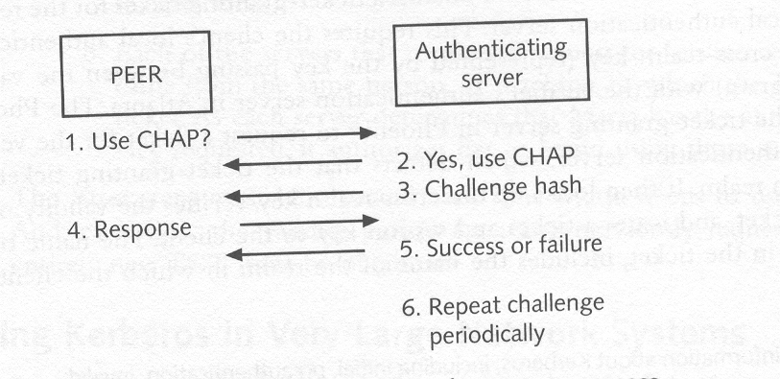
CHAP challenge-and-response process
bmuwonge@cit.mak.ac.ug
MCN 7103: System And Network Security

Slide 43
Digital Certificates
Digital certificates are commonly used to authenticate a person’s or organization’s digital identity on the Internet.
Digital certificates are use in a variety of transactions including e-mail, electronic commerce, and the electronic transfer of funds.
Alice and Bob have never before communicated with each other. When Alice and Bob want to communicate with each other, they can share their plaintext public keys with each other over an insecure line.
bmuwonge@cit.mak.ac.ug
MCN 7103: System And Network Security

Slide 44
If Alice uses Bob’s public key to encrypt a message to him, only Bob can decrypt it using his private key and vice versa.
However, Bob does not know the identity of the sender. Alice’s identity can be verified if she signs the message with a digital signature that has been certified by a Certification Authority (CA) that issued her private and public keys.
This process of using a third party to independently verify the authenticity of an individual is called non-repudiation.
A digital certificate is issued by a CA and signed with CA’s private key.
bmuwonge@cit.mak.ac.ug
MCN 7103: System And Network Security

Slide 45
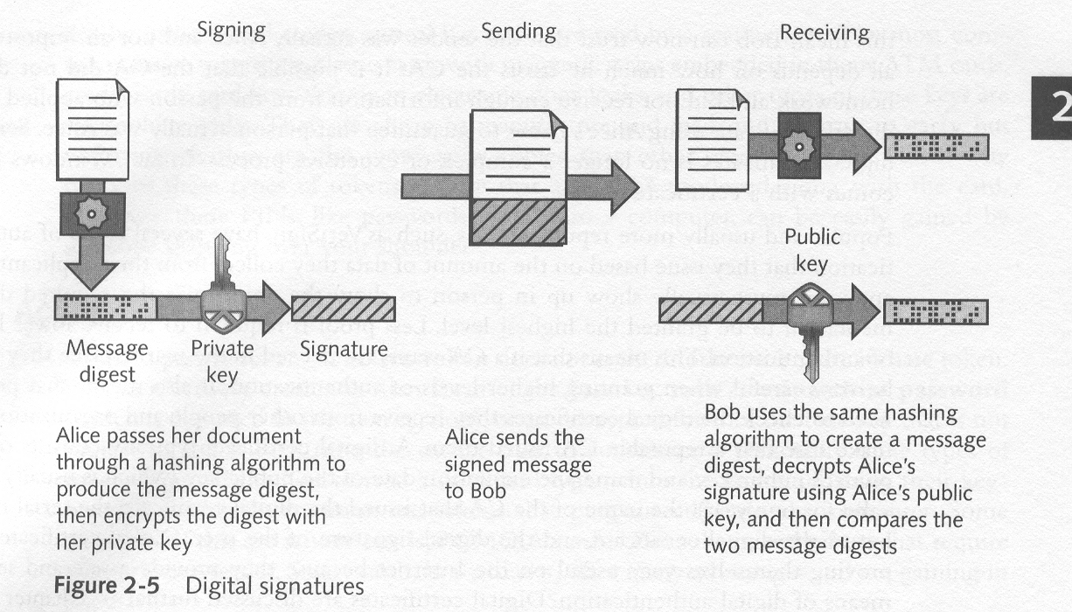
Digital Signatures
bmuwonge@cit.mak.ac.ug
MCN 7103: System And Network Security

Slide 46
Biometrics
Biometrics authentication is based upon an individual’s unique physical or behavioral characteristic.
Physical characteristics that are commonly measured include fingerprints, hand geometry, retinal and iris patterns.
Behavioral characteristics that are commonly measured include handwritten signatures and voice.
Biometric authentication is the most secure because it relies on measuring who an individual is, rather than what they know or what the have.
Physical characteristics are those that are actually part of a person, such as the patterns found on their fingerprint or iris, or the size of the various parts of their hand. E.g., finger printing, Hand geometry authentication, etc…
bmuwonge@cit.mak.ac.ug
MCN 7103: System And Network Security

Slide 47
Fingerprinting:
Takes an image of a person’s fingertips and records its characteristics. The patterns are matched (ink) or encoded (digital) and then compared with other fingerprint records.
With digital scanning, a user presses his or her finger gently against a small optical or silicon reader surface where fingerprint information is taken from the digital scan and sent to a database for verification and identification comparison.
Advantages:
  peace of mind in having no passwords or PIN numbers to remember;
  elimination of expensive password admin; flexibility & interoperability;
  unlimited number of users;
  preservation of privacy
  ease of use; and
  compatibility with all major access control systems.
bmuwonge@cit.mak.ac.ug
MCN 7103: System And Network Security

Slide 48
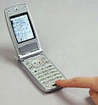
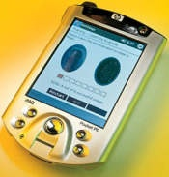
Examples
Casio Computer and Alps Electric have developed a small fingerprint scanner (Fig.1) built into a short, thin cylinder for use in cellular phones & other portable devices.
The cylinder, 0.2 inches in diameter & 0.6 inches long, contains a sensor, light, and lens. When users roll their fingers over the device, it can produce an 8-level monochrome fingerprint image at 600 dots per inch resolution.
Fig.1Casio Cellular Fig.2:HP IPAQ H5450
Scanner
Hewlett-Packard (Fig.2) added biometric identity checking to a mass-market consumer portable electronics device, when it built a small scanner into its HP IPAQ H5450 PDA
bmuwonge@cit.mak.ac.ug
MCN 7103: System And Network Security

Slide 49
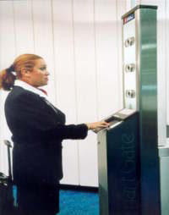
Facial recognition
Analyzes xtics of a person's face. Access is permitted only if a match is found.
User faces digital video camera, standing about 2ft from it; where overall facial structure, including distances between eyes, nose, mouth, & jaw edges measured[see fig.]
ADVANTAGES
Short verification period,
Non-intrusive technology
Flexible commn interfaces
  Terminals can be networked.
Advantages(cont’d).
easy integration into existing access control or time and attendance systems
bmuwonge@cit.mak.ac.ug
MCN 7103: System And Network Security

Slide 50
Challenges
Frustration of verification reattempts.
  Changes in lighting,
  objects in the background distorting a reading,
  Imprecise facial positioning, and expressions of the user can all contribute to verification reattempts.
Scanners inability to recognize countermeasures against a clean photo such as beards, mustaches, and disguises.
Possibility of fake faces or molds affecting a reading.
Legal and privacy issues.
bmuwonge@cit.mak.ac.ug
MCN 7103: System And Network Security

Slide 51
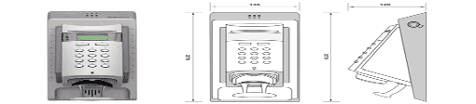
Vascular pattern recognition:
Vascular patterns are a picture of the veins in a person's hand or face. The thickness and location of these veins are believed to be unique enough to an individual to be used to verify a person's identity.
Requires the user to place their hand on or in a curved reader that takes an infrared scan of their veins.
This scan creates a picture that can then be compared to a database to verify a user’s identity.
Advantages:
  great difficulty in emulating another person's vein structure,
  No need to worry about rain, glasses, or external injuries.
Challenges:
  Effects of aging, heart attacks, and medical problems with one's arteries on the scans not determined fully.
  Requires a large amount of space to mount the device so that the entire hand can be scanned; restricting usability.
bmuwonge@cit.mak.ac.ug
MCN 7103: System And Network Security

Slide 52
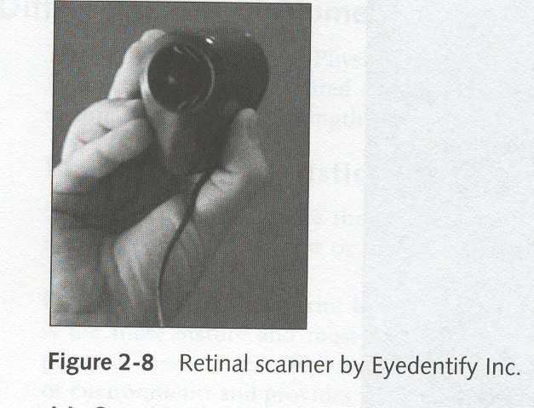
Retinal Scanning
Retinal scanning involves analyzing the layer of blood vessels located at the back of the eye.
This method is highly accurate. However, it is difficult to use because it requires the user to focus on a specific point in a receptacle.
bmuwonge@cit.mak.ac.ug
MCN 7103: System And Network Security

Slide 53
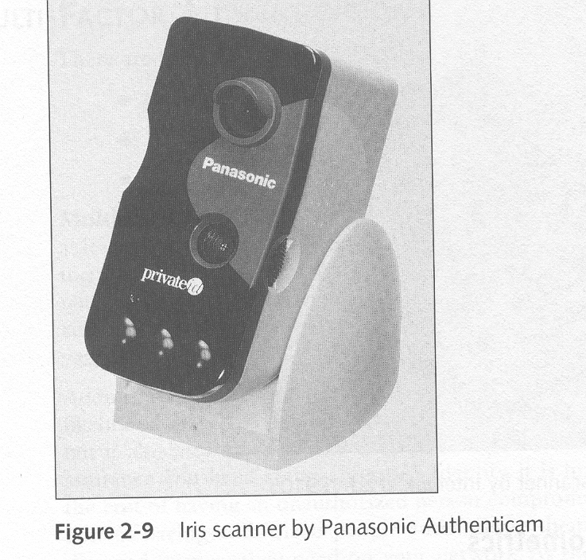
Iris Scanning
Involves analyzing the patterns of the colored part of the eye surrounding the pupil.
Advantage
  Extreme accuracy of technology, since no two irises are alike.
  Involves non-invasive technology; ease of use since irises cannot be stolen, unlike keys, access cards, and password systems
  No need to remember passwords.
  Recognizes a fake eye from a real one by varying the light shone into the eye and watching for pupil dilation.
Challenge
High cost.
Potential difficulty in getting someone to hold their head in the right spot for a scan,
Bad readings due to poor conditions such as lighting, surface positioning if behind a curved, wet, or reflecting surface.

Slide 54
Behavioral characteristics
Behavioral characteristics are those which are exhibited by an individual, such as the way a person signs their name or speaks a predetermined phrase, rather than characteristics that are actually a part of the physical makeup of that person.
bmuwonge@cit.mak.ac.ug
MCN 7103: System And Network Security

Slide 55
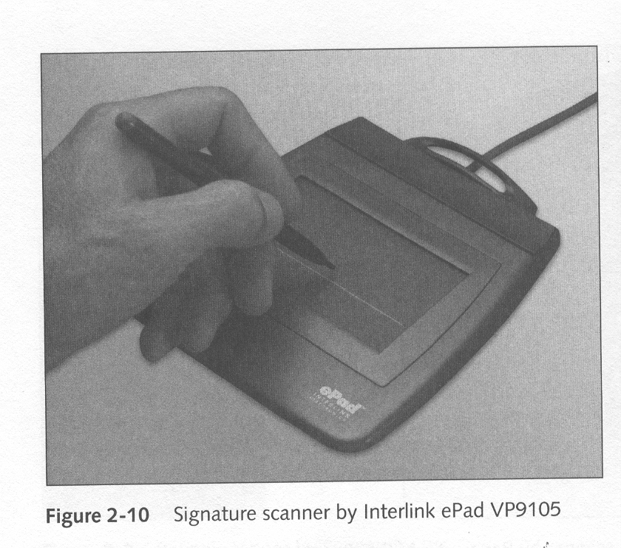
Signature verification
Signature verification analyzes the way someone signs their name, such as speed and pressure, as well as the final static shape of the signature itself.
The main problem is that most people do not sign their name in a consistent manner.
bmuwonge@cit.mak.ac.ug
MCN 7103: System And Network Security

Slide 56
Speaker and voice recognition:
Speaker recognition involves a user speaking into a microphone with his or her password or access phrase.
Systems filter out background noise and take into account microphone variances. Verification is confirmed via a database from a previously recorded voice.
Advantages
  Flexibility to record & accept multiple verifications, speech, and multiple languages;
  Inexpensive cost and implementation - Easily deployable.
  Ease of use, and its acceptance.
The challenges
  Unaccommodating to the hearing impaired.
  Potential of using recorded voices as a breach of access.
bmuwonge@cit.mak.ac.ug
MCN 7103: System And Network Security

Slide 57
Multi-Factor Authentication
There are three commonly recognized factors of authentication:
Something you know, such as password
Something you have, such as a smart card
Who you are (something about you), such as a biometric
bmuwonge@cit.mak.ac.ug
MCN 7103: System And Network Security

Slide 58
Multi-Factor Authentication
Multi-factor authentication requires that an individual be positively identified using at least one means of authentication from at least two of these three factors.
Adding additional factors of authenticity to your identification process decreases the likelihood that an unauthorized person can compromise your electronic security system, but it also increases the cost of maintaining that system.
bmuwonge@cit.mak.ac.ug
MCN 7103: System And Network Security

Slide 59
References
Cryptography and Network Security: Principles and Practice, Third Edition, by William Stallings (2000)
http://x5.net/faqs/crypto/q94.html
http://gost.isi.edu/publications/kerberos-neuman-tso.html
bmuwonge@cit.mak.ac.ug
MCN 7103: System And Network Security
Notes:
The second, illustrated in Figure 1.6, model is concerned with controlled access to information or resources on a computer system, in the presence of possible opponents. Here appropriate controls are needed on the access and within the system, to provide suitable security. Some cryptographic techniques are useful here also.

Slide 60

Q & A
“In life, always expect questions, but do not expect answers”
bmuwonge@cit.mak.ac.ug
MCN 7103: System And Network Security

